Slide 1
Girvan-Newman Clustering
Of Wikipedia
Jeremy Levick

Slide 2

Recommendation algorithms need a notion of “related-to-ness” to give good recommendations:
Can have it implicitly determined by people:

Slide 3
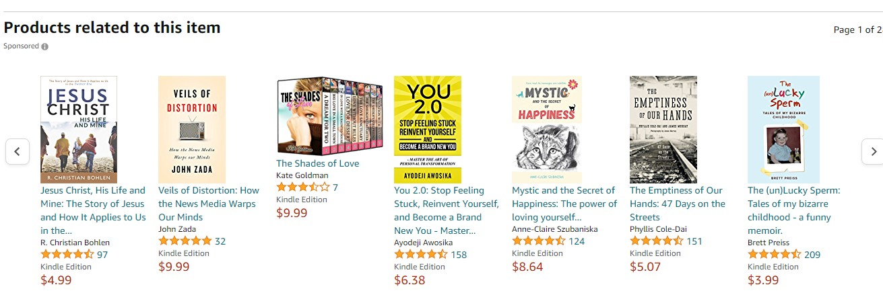
Or generated by some algorithm:

Slide 4
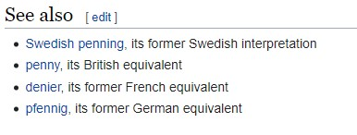
Goal is to leverage Wikipedia as a large source of human-curated information with links between pages as indicating “related-to-ness”

Slide 5
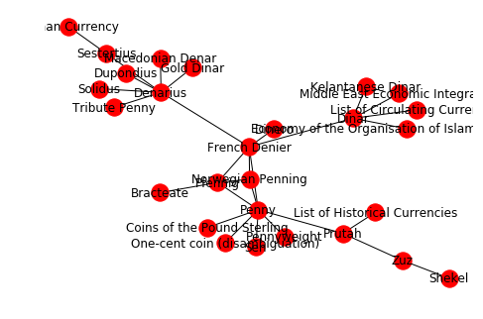
Ultimately giving a connectedness graph

Slide 6
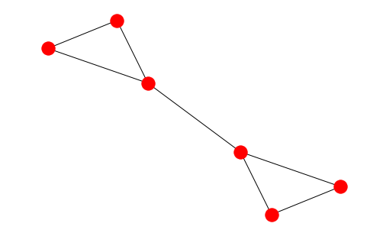
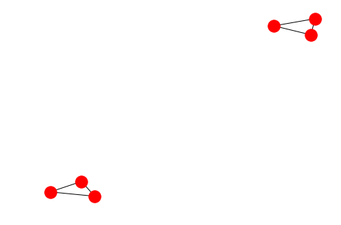
To find clusters, use the Girvan-Newman algorithm, which iteratively cuts the most “weight-bearing” links to disconnect the graph into isolated pieces, corresponding to different categories. The process is hierarchical, remembering how clusters splinter into subclusters.

Slide 7
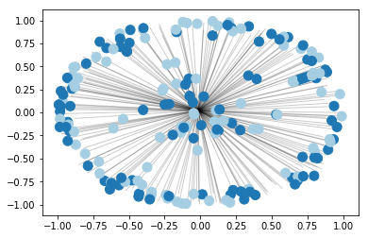
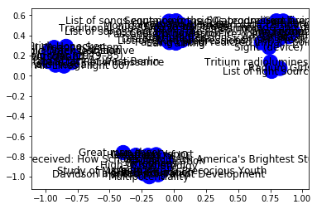
We scrape Wikipedia using Python library BeautifulSoup, and then store connectedness data in a big graph (using NetworkX), as well as a Pandas DataFrame

